Slide 1
TEXT DETECTION AND EXTRACTION USING DEEP LEARNING TECHNIQUES WITH ADD ON FEATURES AS TRANSLATION AND TEXT TO SPEECH
A N A I B A S E D T O O L

Slide 2
T E A M D E T A I L S
Guided By:
Mrs. GEETHA.S ., M.E,AP/AI
Team Members:
AATHIRAJU.M – 811721243001 GOWRI SHANKAR.S – 811721243017 KIRUSHIGAN.R – 811721243025
RAJADURAI.M - 811721243303

Slide 3
O B J E C T I V E
This project focuses on developing a text extraction application using Deep Learning. It leverages the EasyOCR library to accurately extract English and Tamil text from images. Users can translate the extracted text into different languages, enabling seamless text retrieval from various sources.

Slide 4
E X I S T I N G S Y S T E M
Uses OpenCV and Tesseract OCR for text extraction.
Supports only English by default; extensions require extra models. No real-time camera scanning.
Requires manual setup of OpenCV, Tesseract, and dependencies. Language models need separate installation.

Slide 5
P R O P O S E D S Y S T E M
EasyOCR Library:
An open-source tool for extracting multi-lingual text from images, simplifying OCR implementation.
Creates shadow of the text to detect the characters.
Real-time Scanning:
Supports live text detection using webcams or mobile cameras for instant recognition.
Translation:
Allows translation of extracted text into multiple languages, enhancing accessibility.

Slide 6
L I T E R A T U R E S U R V E Y
S.NO.
Paper Title
Author Name
Year of Publish
Techniques Used
Merits
Demerits
1
Extraction Algorithm of English Text Information From Color Images Based on Radial Wavelet Transform
YAQIN WANG
Aug,2020
Pseudo-boundary phenomena.
Text characteristic by color signals.
Noise Reduction Text Localization Scalability
Complexity Limited Language Support Sensitivity to Distorted Text
2
Efficient Text Bounding Box Identification Using Mask R-CNN: Case of Thai Documents
PHANTHAKAN , DITTAYA WANVARIE
& NAGUL
HAROJANANONE
Mar,2024
OCR Module R- CNN
Robust to Variations Adaptability
Slower Processing Complex Architecture High Cost

Slide 7
L I T E R A T U R E S U R V E Y
S.NO.
Paper Title
Author Name
Year of Publish
Techniques Used
Merits
Demerits
3
Cursive Text Recognition in Natural Scene Images Using Deep Convolutional Recurrent Neural Network
MARK R, MD.ASIKUZZAMAN, ASGHAR ALI & MEHWISH LEGHARI
Jan,2022
CNN RNN
OCR Module
Limited Performance Longer Training Sensitive to Blurred Text
Robust to Variations Unconstrained Environment
4
CameraKeyboard: A Novel Interaction Technique for Text Entry Through Smartphone Cameras
ALESSIO BELLINO
& VALERIA
HERSKOVIC
Dec,2020
OCR Module CNN
Open CV
Robust to Variations Faster Input Adaptability
Higher
Processing Requirements Recognition Errors Camera Limitations

Slide 8
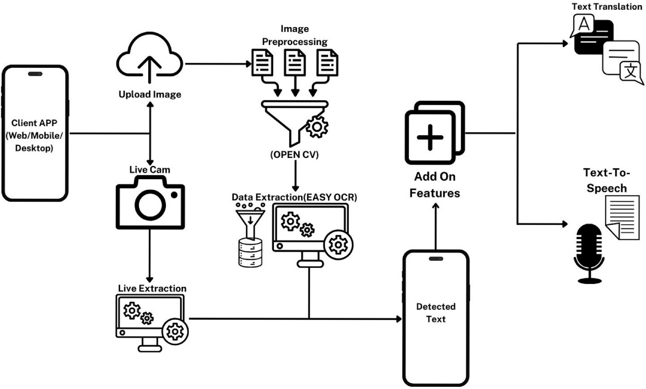
A R C H I T E C T U R E D I A G R A M

Slide 9
S Y S T E M S P E C I F I C A T I O N
Software Requirements
Programming Language: Python 3.7 or later Libraries:
Deep Learning: TensorFlow or PyTorch NLTK
EASYOCR gTTS
Googletrans
Environment: VS Code or Pycharm Database: PostgreSQL or MongoDB Version Control: Git
Operating System: Linux or Windows
Hardware Requirements
GPU: NVIDIA RTX 3050 series or higher with 8GB VRAM or more
CPU: Intel i7/i9 or AMD Ryzen 7 or more with atleast 8 cores
RAM: 16GB or more Storage: 1TB SSD

Slide 10
M O D U L E S
Text Detection and Extraction Module Translation Module
Text-to-Speech Synthesis Module User Interface
Data Preprocessing Module Post-Processing Module

Slide 11
M O D U L E S
1. TEXT DETECTION AND EXTRACTION MODULE:
Purpose - To detect text from the uploaded image or live image using EasyOCR
Key Features -
Accurate Text Recognition: Extracts text from images, scanned documents, and PDFs with precision.
Multilingual Support: Detects and extracts text in multiple languages. Flexible Input Handling: Supports various formats like JPG, PNG, and PDF.
Post-Processing Capabilities: Enhances extracted text with spell correction and formatting.
A Text Detection and Extraction Module identifies and extracts text from images or scanned documents using techniques like OCR, enabling data retrieval for analysis, processing, or storage efficiently.

Slide 12
M O D U L E S
1. TEXT DETECTION AND EXTRACTION MODULE:
Benefits:
Improved Data Accuracy Enhanced Process Efficiency Reduced Manual Effort
Use Cases:
Invoice Data Extraction ID Card Recognition Document Digitization

Slide 13
M O D U L E S
TRANSLATION MODULE
Purpose - Facilitates the conversion of text from one language to another for improved communication and understanding.
Features-
Language Support: Translates text, speech, and documents across multiple languages.
Context Awareness: Ensures accurate translations by understanding context. 3. Customization Options: Allows integration of domain-specific terminology.
4. Real-time Translation: Provides instant translation for live interactions.
A translation module is a software component or system responsible for converting text or speech from one language to another, ensuring accurate and contextually appropriate language transformation for communication.

Slide 14
M O D U L E S
2. TRANSLATION MODULE:
Benefits
Quick and accurate translation. Breaks language barriers effortlessly. Reduces manual translation costs.
Use Cases
Multilingual product descriptions Real-time multilingual chat support. Adapts content for global audiences.

Slide 15
M O D U L E S
3. TEXT-TO-SPEECH SYNTHESIS MODULE
Purpose - The purpose of the Text-to-Speech Synthesis Module is to convert written text into natural-sounding spoken language.
Key Features -
Natural-sounding Voice Generation: Converts text into human-like speech with natural intonation and rhythm.
Multiple Language Support: Offers voice synthesis in various languages and dialects for global accessibility.
Customizable Voice Options: Allows users to select different voices, accents, and speaking speeds.
Real-time Processing: Provides immediate text-to-speech conversion for interactive applications.
A Text-to-Speech (TTS) Synthesis Module is a system that converts written text into spoken voice output using artificial intelligence and speech processing technologies.

Slide 16
M O D U L E S
3. TEXT-TO-SPEECH SYNTHESIS MODULE
Benefits:
Enhances learning experiences Promotes interactive experiences Hands-free operation
Use Cases :
Assists in language learning Automates phone support Guides drivers with directions

Slide 17
M O D U L E S
4.USER INTERFACE
Purpose - The purpose of a User Interface (UI) is to provide an intuitive and interactive platform for users to efficiently interact with software or systems.
Key Features -
Intuitive Design - Ensures easy navigation for users. Responsive Layout - Adapts to different screen sizes. Accessibility Features - Supports users with disabilities.
Interactive Elements - Enhances user engagement and interaction
The purpose of the User Interface (UI) is to provide an intuitive, interactive platform for users to interact with software or systems, enhancing usability, accessibility, and overall user experience.

Slide 18
M O D U L E S
4.USER INTERFACE
Benefits:
Enhances user experience Improves accessibility features Ensures seamless navigation
Use Cases :
Visualizes data effectively Simplifies data analysis Provides real-time insights

Slide 19
M O D U L E S
5.DATA PREPROCESSING MODULE
Purpose - The purpose of the Data Preprocessing Module is to clean, transform, and prepare raw data for analysis or machine learning models.
Key Features -
Data Cleaning - Removes inconsistencies, duplicates, and errors. Feature Selection - Identifies and selects relevant features for analysis.
Data Transformation - Normalizes, scales, and encodes data for modeling. Missing Value Handling - Imputes or removes missing data points.
The Data Preprocessing Module is responsible for cleaning, transforming, and organizing raw data into a structured format suitable for analysis or modeling.

Slide 20
M O D U L E S
5.DATA PREPROCESSING MODULE
Benefits:
Removes duplicates and errors Handles missing data Standardizes data format
Use Cases :
Extracts relevant features Improves model performance Enhances data understanding

Slide 21
M O D U L E S
6.POST-PROCESSING MODULE
Purpose - The purpose of the Post-Processing Module is to refine, evaluate, and format raw data or model outputs into actionable insights and user-friendly results.
Key Features -
Error Detection and Correction: Identifies and fixes inaccuracies in results. Result Formatting: Converts raw data into a structured, readable format.
Data Integration: Combines diverse outputs into a unified report.
Performance Metrics Generation: Provides evaluation metrics for model performance.
The Post-Processing Module is responsible for refining, formatting, and optimizing raw data or model outputs to ensure accuracy, clarity, and usability for analysis or decision-making.

Slide 22
M O D U L E S
6.POST-PROCESSING MODULE
Benefits:
Analyzes model performance Generates evaluation metrics Validates model accuracy
Use Cases :
Refines raw results Reduces errors Enhances data quality

Slide 23
A D V A N T A G E S
Enhanced Text Recognition Accuracy Supports Multiple Language Translation Improved Accessibility for Users
Faster Data Extraction Process Seamless Integration with Applications

Slide 24
C O N C L U S I O N
In conclusion, Text Detection and Extraction using Deep Learning Techniques with integrated features like Translation and Text-to-Speech offers a powerful solution for extracting and processing text from images or documents. This enhanced system improves accessibility, enables multilingual support, and provides seamless audio output, ensuring greater user convenience and engagement.

Slide 25


Thank you!

